Slide 1

INSTITUTE :UIE
DEPARTMENT: ALL ACADEMIC UNITS
Bachelor of Engineering (All Sections)
Subject Name and Code:
Engineering Physics 23SPH-141
Prepared by: Ms. Arminder
UNIT 3
QUANTUM MECHANICS
DISCOVER . LEARN . EMPOWER

Slide 2
COURSE OBJECTIVES
The course is designed to make the students industry ready to contribute in the growing demand of the industry at local, national and international level.
It will make the students competent to understand basic concepts and applications of advanced engineering physics and apply its principles in their respective fields at global platform.
It will enhance the skill level of the students and shall make them preferred choice for getting employment in industry and research labs.
It will give thorough knowledge of the discipline to enable students to disseminate knowledge in pursuing excellence in academic areas.

Slide 3

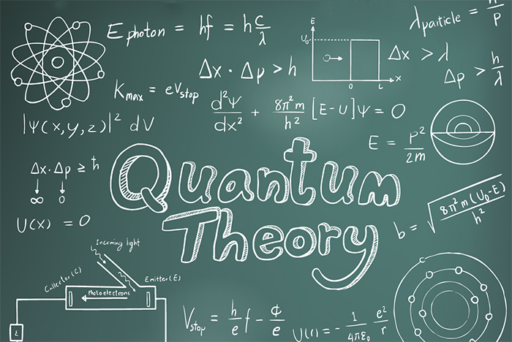
COURSE OUTCOME
CO Number | Title On completion of this course, the students are expected to learn | Level
CO1 | Quote the basic fundamental concepts of lasers, optical fibres, crystallography, ultrasonic oscillations, semiconductor physics, quantum mechanics and nanotechnology. | Remember, Understand
CO2 | Demonstrate the working of various lasers, fibre components, semiconductor devices; explain the behaviour of crystalline solids, quantum and nano-scale systems. | Understand
CO3 | Solve problems by applying principles related to lasers, fibres, semiconductors, oscillations, quantum and nanoscience. | Applying
CO4 | Compare various lasers and fibres, semiconducting devices, crystalline materials, structures at quantum and nanoscale on the basis of their properties for industrial applications. | Analyze
CO5 | Develop various systems using lasers, fibres, semiconductors and nanomaterials for futuristic applications. | Design
Figure 1 Quantum Theory [1]

Slide 4
INTRODUCTION
UNIT -3
QUANTUM MECHANICS
TIME INDEPENDENT SCHRODINGER EQUATION

Slide 5
LECTURE OBJECTIVE
1
Students will learn about wave function.
2
Students will learn about different quantum variables.
3
Derive time independent equation.

Slide 6
CONTENT
Photon-momentum
Schrodinger’s cat
Introduction
Time-independent Schrodinger’s equation

Slide 7
PHOTON MOMENTUM
IN FREE SPACE:
IN OPTICAL MATERIALS:

Slide 8
SCHRÖDINGER'S CAT
“It is typical of these cases that an indeterminacy originally restricted to the atomic domain becomes transformed into macroscopic indeterminacy, which can then be resolved by direct observation. That prevents us from so naively accepting as valid a "blurred model" for representing reality. In itself, it would not embody anything unclear or contradictory. There is a difference between a shaky or out-of-focus photograph and a snapshot of clouds and fog banks.”
-Erwin Schrodinger, 1935

Slide 9
SCHRODINGER EQUATION-INTRODUCTION
Schrödinger Equation is a mathematical expression which describes the change of a physical quantity over time in which the quantum effects like wave-particle duality are significant. The Schrödinger Equation has two forms the time-dependent Schrödinger Equation and the time-independent Schrödinger Equation.

Slide 10
TIME INDEPENDENT SCHRODINGER EQUATION
A very important special case of the Schrodinger equation is the situation when the potential energy term does not depend on time. In fact, this particular case will cover most of the problems
As the name implies, this is the situation when the potential depends only on position.
If ᴪ(x,t) = ᴪ(x), then the Schrodinger equation becomes

Slide 11
TIME INDEPENDENT SCHRODINGER EQUATION
Ψ(x,t) = Ae^{i(kx)} e ^{−iωt} ………. (1)
ᴪo = Ae^{i(kx)}
Ψ(x,t) = ᴪo e ^{−iωt} ………….(2)
Using time dependent equation
− ℏ²/ 2m ∂²ψ/ ∂x² + V (x)Ψ = iℏ ∂ψ/ ∂t…….(3)
Double Differentiate 2 with respect to x, which results into
∂²ψ/ ∂x² = ∂²ψo/ ∂x² e ^{−iωt} ………(4)

Slide 12
TIME INDEPENDENT SCHRODINGER EQUATION
Differentiate 1 with respect to time t
∂ψ/ ∂t = -iωᴪo e ^{−iωt} …………..(5)
Put 4 and 5 equations in equation 3
− ℏ²/ 2m ∂²ψo/ ∂x² e ^{−iωt} + V (x) ᴪo e ^{−iωt} = iℏ -iωᴪo e ^{−iωt}
Extracting common terms i.e. e ^{−iωt}
− ℏ²/ 2m ∂²ψo/ ∂x² + V (x) ᴪo = ℏω ᴪo
This is one-dimensional time independent Schrodinger wave equation.

Slide 13
SUMMARY
Time independent Schrodinger equation is given as
− ℏ²/ 2m ∂²ψo/ ∂x² + V (x) ᴪo = ℏω ᴪo

Slide 14
FREQUENTLY ASKED QUESTIONS
Give energy and momentum operator.
Derive time independent Schrodinger equation.
If the particle moving in a _____ potential then the solution of the wave equation are describe as a stationary states
(a) time independent (b) time dependent (c) velocity dependent (d) velocity independent

Slide 15
REFERENCE-BOOKS
Concepts of Modern Physics, (Fifth Edition) A Beiser, McGraw Hill International.
Fundamentals of Physics, David Halliday, Robert Resnick and Jearl Walker, Wileyplus.

Slide 16
REFERENCE -VIDEOS
https://www.youtube.com/watch?v=Dt_VKsSggAo
https://www.youtube.com/watch?v=lB9cFdOoLaQ

Slide 17
REFERENCE-WEBSITE
http://physics.mq.edu.au/~jcresser/Phys201/LectureNotes/SchrodingerEqn.pdf
https://nanohub.org/resources/4935/download/tiswe_part1.pdf
http://lejpt.academicdirect.org/A26/031_048.pdf

Slide 18
THANK YOU
For queries
Email: arminder.uis@cumail.in

